Slide 1
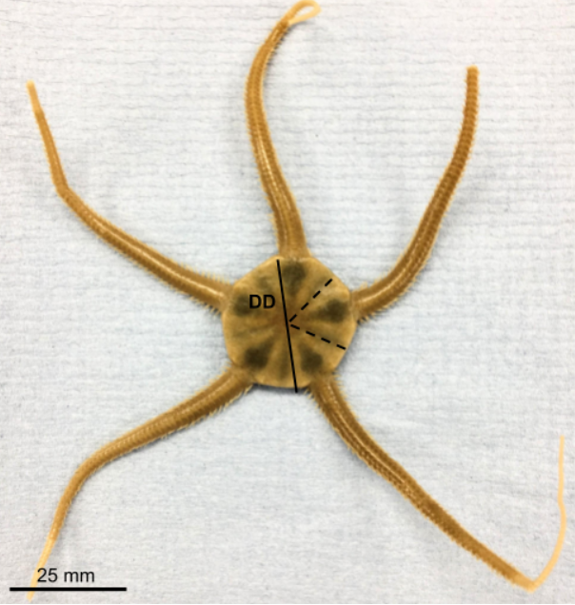
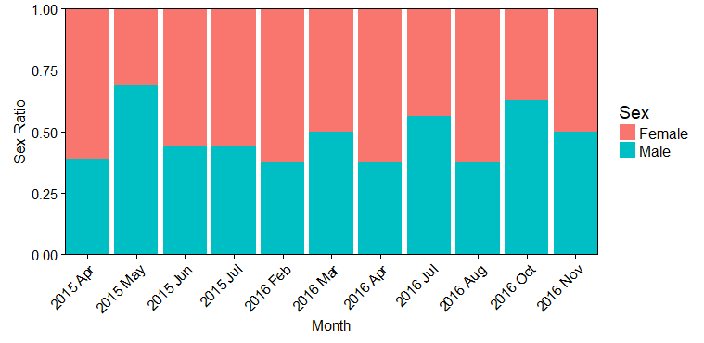
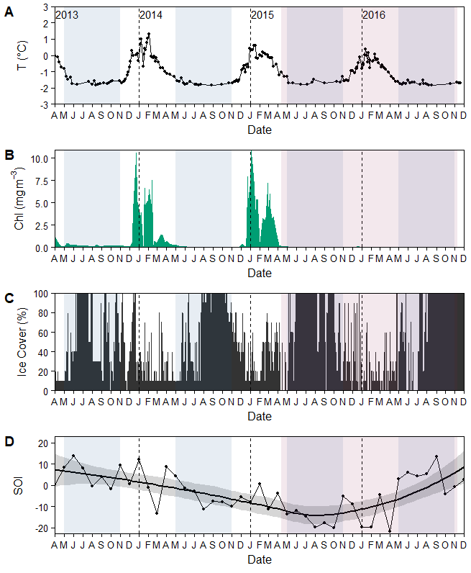
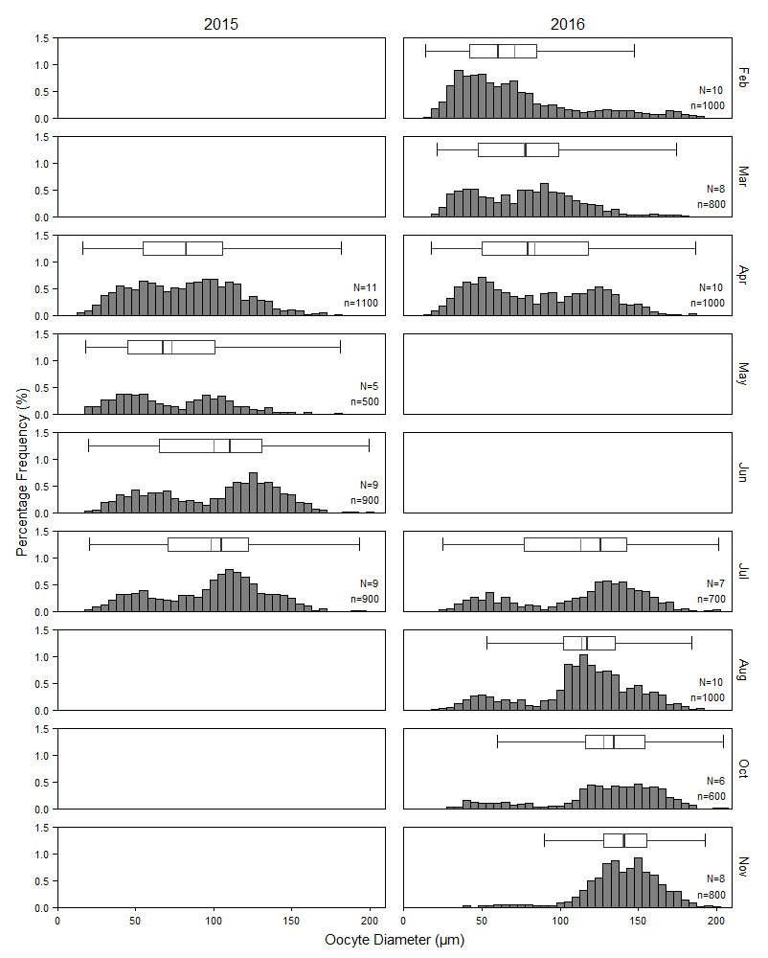
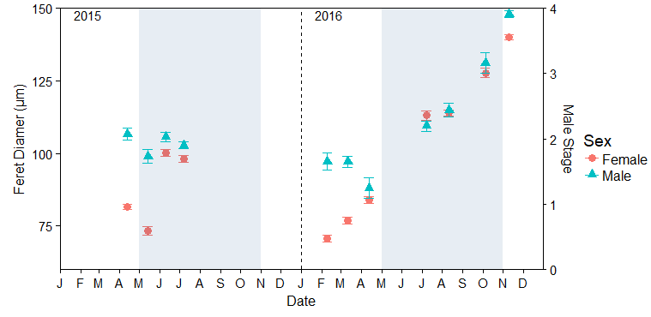
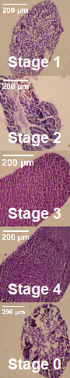
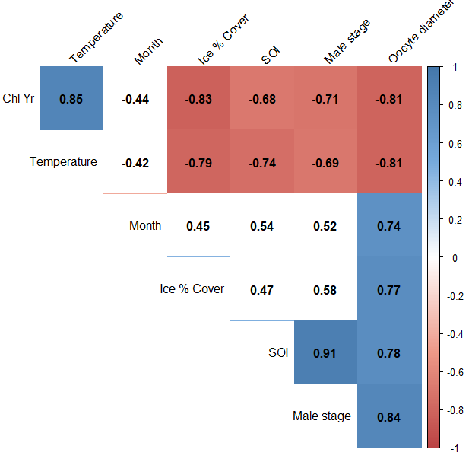


Gametogenic Ecology of Antarctic Brittle Star: Ophionotus victoriae
Msci MarBio Dissertation Presentation 2018
Victoria Gillman
1. Background
West Antarctic Peninsula has a highly seasonal photoperiod against a stable background temperature¹.
Benthic communities make up ~80% of the Southern Ocean biodiversity, where 50 - 97% are endemic².
Antarctic benthic invertebrates are stenothermal and have extended reproductive cycles^{3,4}
Successful reproduction allows survival amid climate change, but few long-term data studies assess Antarctic reproductive ecology ^{4,5}.
Ophionotus victoriae, a circum-polar brittle star, has been collected for Rothera Time Series (RaTS) since 1997 ^{(3,4)}.
4. Result: Sex Ratio 1:1
Frequencies did not differ significantly between sexes (χ² = 7.54, p = 0.673).
Ratio variations occur due to ecological differences in behaviour⁴
Fig. 1. O. victoriae, bar= 25 mm
5. Result: Annual Variation
Gonad index, oocyte diameter and male maturity stages differed significantly over time.
Gonad index (Two- way ANOVA, F_{(10,156)} = 3.08, p = 0.001).
Oocyte diameter (χ2 = 4149.2, p < 0.001).
Male maturity staging (χ2 = 435.5, p-value < 0.001).
Each increased February to November before decreasing November-January (austral summer), indicating spawning.
Oocyte bimodal distribution follows right to left skew over year (maturation), unimodal in austral summer (spawning)
Oocyte retention during summer = 18-24 month oogenesis
Fig. 3. O. victoriae monthly sex ratio
2. Aims
The aim of this study is to measure the reproductive ecology of O. victoriae over time. This includes:
Using gonad index, oocyte diameter and male maturity staging to identify seasonal cycles.
Comparing male and female frequencies and maturity.
Assessing reproductive relationships with environmental data
Fig. 4. Monthly oocyte diameter in 5µm bins. Blank=no data. N= 9300
3. Methods
Hand collected, N = 178, n = 16 – 18 :
Rothera Research Station, West Antarctic Peninsula (67°34’ S, 68°08’ W).
11 months between 13/4/2015 to 10/11/2016 at 15 m.
Obtained environmental data from RaTS.
Gonad wet mass (GW, g) and disk diameter (DD, mm) used to
6. Result: Synchrony
No significant difference between male/female gonad indexes.
Oocyte diameter and male maturity stages were synchronous throughout year (Fig. 5, Spearman's rank ρ= 0.84, p-value = 0.003).
Males spawned later than females. Could increase fertilisation success. Present in other ophiuroids⁶.
calculate Gonad index (GI, %):
Histological sections of gonads photographed.
Egg diameter calculated as equivalent circular diameter (ECD) of egg area (A):
Male maturity index was measured as a comparison of testes photographs with staging key (Fig. 2).
Fig. 5. Average oocyte diameter and male maturity stage (±SE, from spent (0) to mature (4)). Grey shading= winter
7. Result: High correlation with local environment data
8. Conclusions
O. victoriae gametogenesis has seasonal cycles.
O. victoriae have synchronous male/female reproductive cycles which improves fertilisation success and is controlled throughout the cycle.
O. victoriae have extended 18 – 24 month oogenesis allowing energy investment without trade-off with somatic system
Reproductive cycles are fundamentally linked with environmental processes and are at high risk to climate change
Positive temperature correlation. Common in ophiuriod reproductive cycles as co-varies with seasons⁶.
Positive sea-ice correlation low due to subjective data. Sea-ice indirectly impact O. victoriae via influence of photoperiod and scouring events⁷.
Positive total chlorophyll correlation, both reproduction and phytoplankton bloom not directly linked.
Southern Oscillation Index (SOI) positive correlation. SOI influences inter-annual trends in temperature, sea-ice and wind⁸. SOI may be an over-arching factor influencing O. victoriae gametogenic cycles
Fig. 2. Histological testes sections of Ophionotus victoriae
Fig. 6. Spearman's Rank matrix, numbers represent Spearman rank value and cells highlighted have p-value <0.05.
References
Clarke, A., Meredith, M. P., Wallace, M. I., Brandon, M. A. & Thomas, D. N. Deep Sea Res. Part II Top. Stud. Oceanogr. 55, 1988–2006 (2008).
Broyer, C. de & Koubbi, P. Biogeographic Atlas of the Southern Ocean. Census of Antarctic Marine Life (2014).
Peck, L. S., Massey, A., Thorne, M. A. S. & Clark, M. S. Polar Biol. 32, 399–402 (2009).
Grange, L. J. L., Tyler, P. A., Peck, L. L. S. & Cornelius, N. Mar. Ecol. Prog. Ser. 278, 141–155 (2004).
Obermüller, B., Morley, S., Barnes, D. & Peck, L. Mar. Ecol. Prog. Ser. 415, 109–126 (2010).
Hendler, G. in Reproduction of Marine Invertebrates (eds. Giese, A. C. & Pearse, J. S.) 355–511 (1991).
Clark, G. F., Stark, J. S., Palmer, A. S., Riddle, M. J. & Johnston, E. L. PLoS One 12, e0168391 (2017).
Holland, P. R. & Kwok, R. Nat. Geosci. 5, 872–875 (2012).
Author contact details
Email: vg3g14@soton.ac.uk
Student ID: 26998076

